Slide 1


Innovative plan for improving bike services in Denmark with the focus on DTU students
Researcher:
Pooya Gh. Sorboni
January 2020

Slide 2




Outline
Best regions
Conclusion & Future studies
Data usage (magic of data)
Data analysis and visualization
Introduction

Slide 3

Introduction
Why bikes
Geographic condition of Denmark
I speak English, Persian, very little Danish
no hills and ups and downs in the streets make it very easy for different age range of people to use
The high taxes of the fuel and rather expensive prices for public transportations, have turned bikes very valuable means of transportation for people

Slide 4

Problem
There is high price of bike services (it can be around 300 dkk for a normal service)
There are not sufficient service points around DTU
There is a time limit

Slide 5

Who can benefit
Students

Slide 6
Data usage (magic of data)
Geographic map of Denmark
Postal code details of each region
Population of each region as per postal code
Clustering the area and finding the best points for our business
Calculating the revenue

Slide 7

Main data source
Danish data center

Slide 8

Data analysis and visualization
How our data looks like

Slide 9
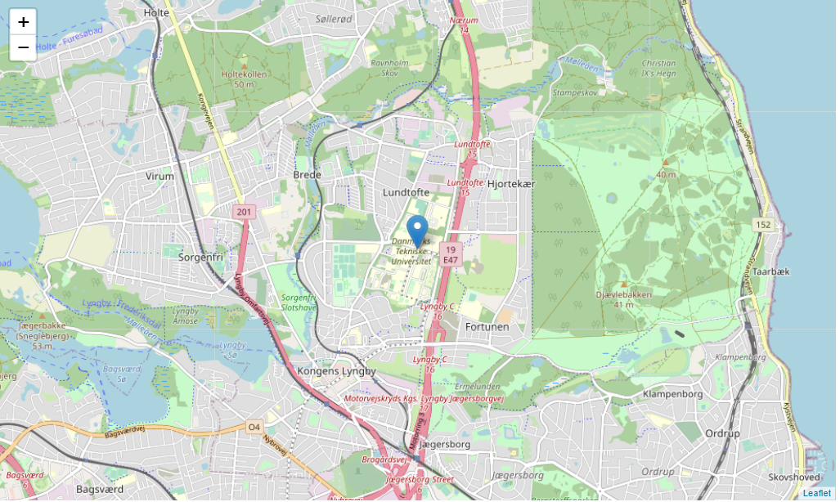
Data analysis and visualization
Area of interest (DTU)

Slide 10
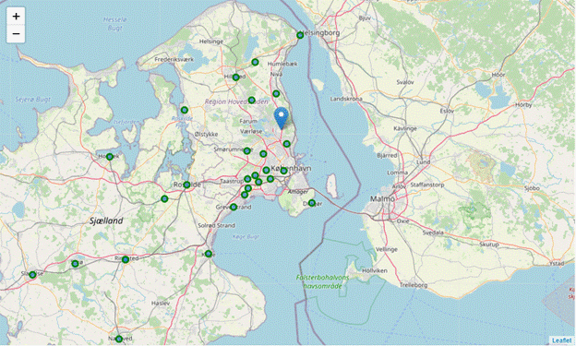
Data analysis and visualization
Regional data (regions around the area of interest)

Slide 11
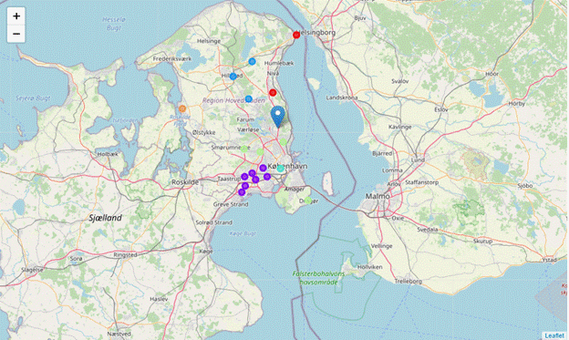
Best regions
Implementing the clustering and segmentation
K value = 6
Closest regions to area of interest:
Regions 0 , 2 , 4

Slide 12
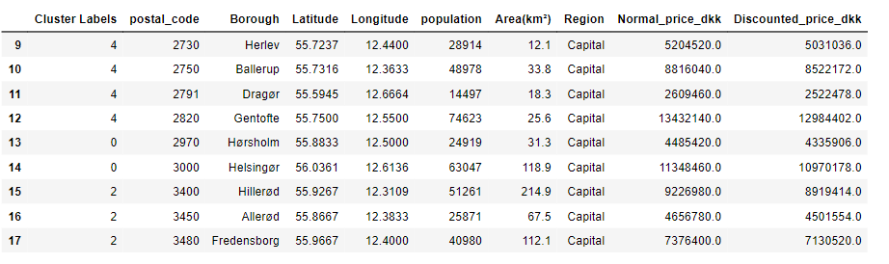
Calculating the business benefit
Geothermal?
The average value of 300 dkk for a normal service) has been used
The offered price by the startup has been chosen to be 10 dkk lower than the average price (which is not a big difference)
As a rule of thumb, it is assumed that 60% of the population in these regions can use bike therefore require at least yearly bike services (assumption is based on the total percentage of people using bike in Denmark (60%)

Slide 13
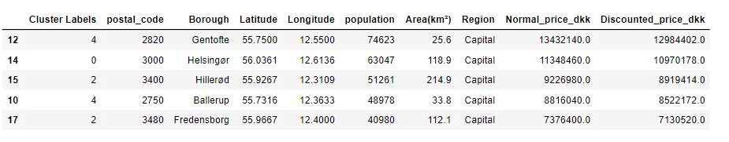
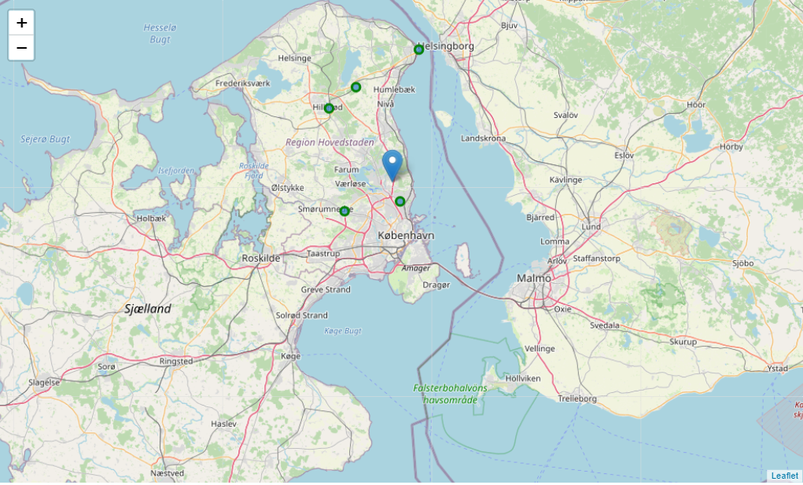
Top 5 locations with best profit

Slide 14

Offering a wider business range
5% discount for the normal price
10% discount for the normal price
15% discount for the normal price
20% discount for the normal price
let’s assume 10% of people using normal price now will start using the new service
so, the community of users of normal shops will reduce by 10% and on the other hand, the community of people using the new service increases by 10%

Slide 15
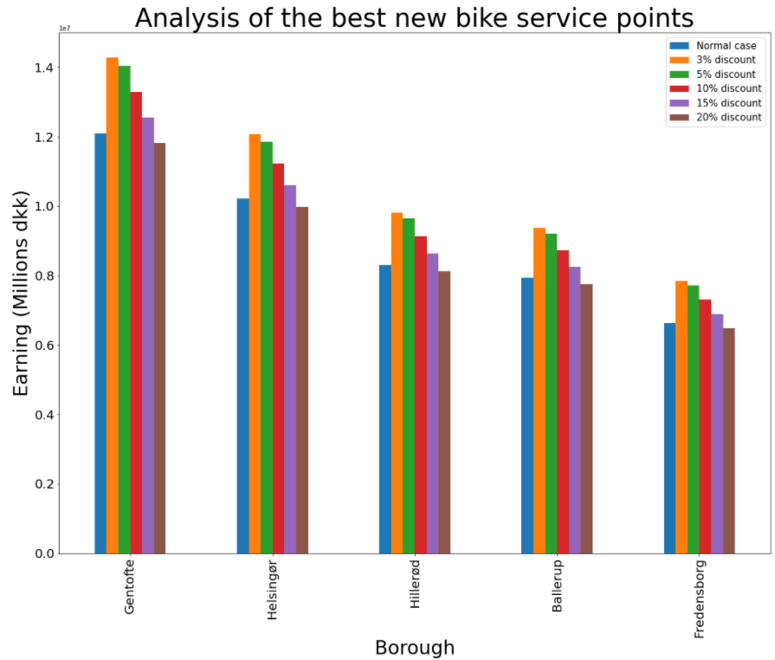
How does it look like

Slide 16
Conclusion
15% discount
5% Discount
Normal price
10% discount
3% Discount
20% Discount

Slide 17
Conclusion/Future works
Great benefit of the new plan
Even 20% discount can be very competitive with the current business status
Current assumptions (community of people using the new service) is very tough, so the real result will be much more promissing
A more detailed datset for the postal codes that include sub zones is recommended to be used
Consider other factots (time limit) and crew fee. As implementing a vending machine doesnt have such limits, the real benefit in compared to the current prices will be even more promissing

Slide 18
Thanks for your time

